Slide 1

Hot Topics
- Summer 2024

Slide 2

What we will cover
Annual Benefit Statements
ABS – Remedy
Modeller Update
Pension Saving Statements
PSS - Remedy
Q & A

Slide 3

What is an ABS?
The Annual Benefit Statement is a document members receive once a year showing a snapshot of their pension benefits
as of the 31st March.
By the
31st August
Notes:
Note – this is not a projection to normal pension age nor is it an early retirement figure– it shows what they have accrued up to 31st March that year.
The distribution schedule is now live on the scheme website which shows a more specific time slot of either 20th June – 15th July, or;
18th July – 12th August
Note – the legislative deadline for issuing ABS is 6th October, however we aim to have all produced by end of August.

Slide 4

Who receives an ABS?
-They must be an active or active pensioner member of the Civil Service pension scheme (CSPS) at the time of production.
-They were an active member or active pensioner member of the CSPS on 31 March 2024.

Slide 5

Who receives an ABS?
Employers must have also provided the Scheme Administrator with a sufficient record of pensionable earnings for alpha members for the 2023/24 scheme year.
All calculations we perform are based on the information supplied by you as the employer.

Slide 6

Paperless ABS
Benefit statements have been paperless since 2021
They are updated to the Pension Portal, which can be accessed on the desktop, or app version.
Exemptions
Those who have opted in to still receive paper copies (around 2%).
Those paid in euros.
Notes:
Members must have opted in by 31st May for the opt in to take effect. To opt in they had to email paper@mycsp.co.uk with their full name, member number & DOB.
Why paperless? – Up to 2021, we produced over half a million statements each year, using seven million pieces of paper. By going paperless, we can save over 100 tonnes of CO2 as well as giving you quicker, easier and more secure access to your ABS.

Slide 7

www.civilservicepensionscheme.org.uk
portal@mycsp.co.uk
View most recent ABS
Update address
Check Death Benefit nominee(s)
Use retirement modeller
Notes:
318.8k active members registered on the portal 55.6% as at end of May

Slide 8
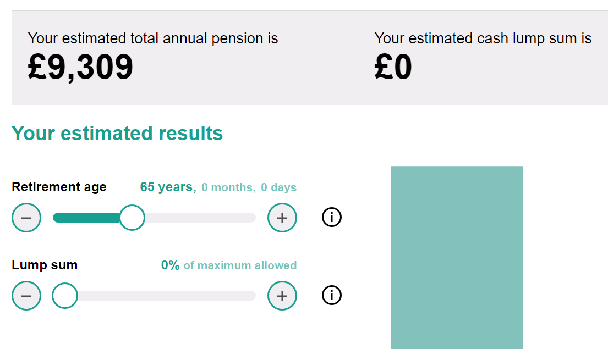

Retirement modeller
Notes:
DOB 29/03/1964
Static pensionable pay of £30,000 throughout service
Retirement date 29/03/2029 – 65

Slide 9

Change to the 2023/24 Statements
-Remedy
If a member is affected by the 2015 Remedy:
the figures shown in their ABS may be different to previous years; and
the benefits in alpha will start from
1 April 2022

Slide 10
Remedy rollback
Rolling back service for Remedy-impacted members means many will see a change from this benefit statement to last.
Legacy benefits to 31st March 2022
alpha benefits from 1st April 2022
Notes:
Highlight alpha not being service based, so if for example someone moved to alpha on 01/04/15 their service last year would have stopped to that point, but now their record is rolled back if they were classic, classic plus or premium in their legacy scheme, this service will now reflect up to 31/03/22 and their alpha pension will be less.

Slide 11

Introducing
What is the Remedy?
Am I affected?
How am I affected?
Making your choice
Different circumstance
Other considerations
Further support
Notes:
Remedy Pension Power (mycsp.co.uk)
Members can book onto open sessions using this link

Slide 12

The sections of the ABS

Slide 13
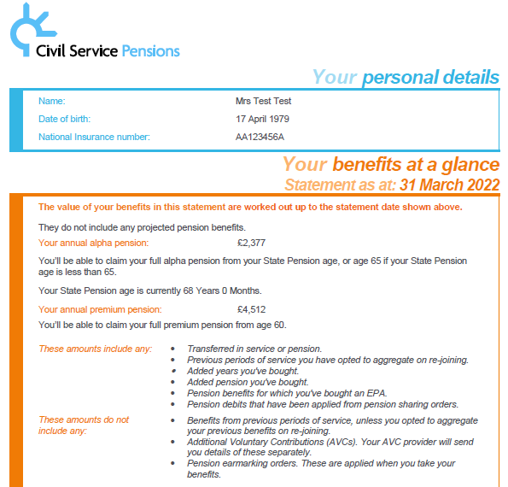
Benefits at a glance
‘Benefits at a glance’ gives an overview of the benefits accrued as of 31st March that year and the normal pension age they can be claimed from.
Notes:
This is the main section members should be looking at, to see what they have accrued overall for their active pensions up to 31st March that year and the normal pension ages for each section. If they have dual membership, both schemes will be shown here.

Slide 14
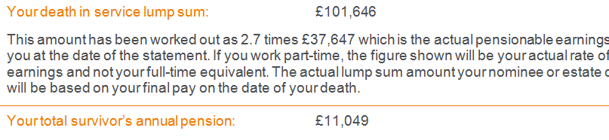
Death benefits
Death benefits are also shown in the ‘Benefits at a glance’ section.
Notes:
Death benefit nominee:
Multiple nominees. This doesn’t have to be a family members, it can be anybody!
Survivors annual pension:
Classic – spouse/civil partner only
All other schemes – co habiting partners also recognised. Not mandatory to nominate however if a member has a cohabiting partner ideally they would complete a partner details form from the website.

Slide 15
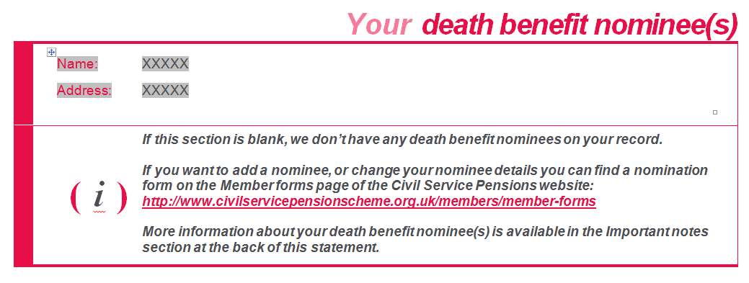
Death benefit nominee
The person the member has nominated to receive the death in service lump sum is shown in this section.
Notes:
If this section is blank, it usually means the member did not have a nomination at the time the statement was produced.
Recent data shows that roughly half of active civil servants do not have a death benefit nomination!

Slide 16
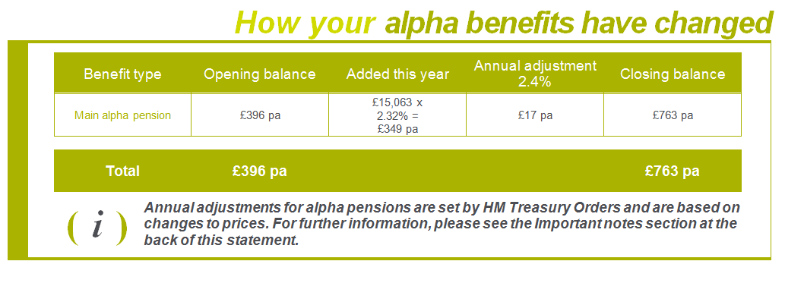
Your alpha benefits
The following page shows how the members alpha benefits have built up over the previous 12 months.
Notes:
This section starts by telling members the date they joined alpha, how long they’ve spent in the alpha scheme, the normal pension age and the pensionable earnings figure that we have used for the last 12 months accrual prior to the date of the statement. It then proceeds to show a break down (as per slide).
Opening balance – annual alpha pension without the last 12 months accrual added.
Added this year – 2.32% of pensionable earnings
Annual adjustment – The total amount is adjusted with CPI (Consumer Price Index). Important to note that if CPI is a negative, the alpha annual pension will be reduced to reflect this. (alpha is linked to Treasury Orders).
Closing balance – the annual pension rate after this years accrual and inflation adjustments.

Slide 17
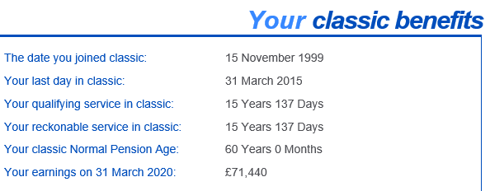
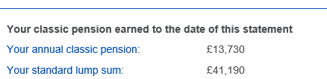
Final salary
The reckonable service & pensionable earnings
used to calculate final salary benefits, and the resulting pension benefits.
Notes:
Qualifying service is the length of time the member has spent contributing to the scheme. Reckonable service is the actual service we use to calculate the final salary pension scheme. This excludes any unpaid breaks or absences and also reflects any part time work – calculated on a pro rate basis proportionate to the hours worked compared to the full time equivalent.
The pensionable pay shown on the statement is the pensionable earnings in the 12 months prior to the 31st March. This is to make sure we don’t over estimate anyone by using a previous, higher salary that may fall off the 3/13 year period down the line.

Slide 18
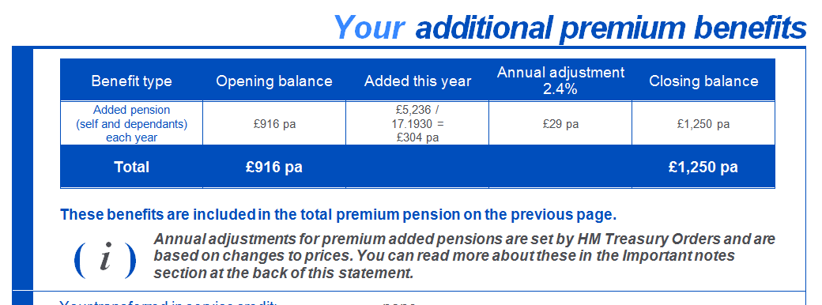
Additional benefits
Any added pension, added years or transferred in service for the final salary elements will show on this page.
They are already included in the figures shown earlier in the statement.
Notes:
These figures have already been included in the ‘benefits at a glance’ section, this page simply gives a break down of the additional benefits for information.
Important - unless the additional benefits/transfer in case is confirmed to be finalised/set up by 31st March then it wont show until the following years statement.

Slide 19

Support available for members
The Annual Benefit Statement landing page on the scheme website
https://www.civilservicepensionscheme.org.uk/your-pension/yearly-pension-update/annual-benefit-statement-abs/
Distribution schedule
Understanding your ABS video
Guide to registering for the pension portal

Slide 20
Member queries
Query RE personal information
This should be updated through the pension portal or employer who will update us via the interface.
Query RE pensionable information
This should be raised through: Contact us - Civil Service Pension Scheme
Notes:
Incorrect personal information shouldn’t have an effect on the members pension calculation.
If a members query regarding their pensionable information contradicts what we hold, we may need to contact you the employer (the data owner) to clarify.

Slide 21
Raising queries
If the information the member gives us doesn’t match what we hold, we will likely need to contact you for clarification using a DR1 form.
ABS queries are worked through in order of receipt and complexity.
Notes:
You are the data owner and the scheme administrator is the data processor. Therefore we cant make any changes to the data we hold unless instructed to do by you. This is why we have an official/auditable process in place.

Slide 22

ABS MI
-Once ABS have been distributed, the Scheme Administrator will provide MI of the members in your organisation they have produced statements for. This will be provided to you by 6 September 2024. -If you have any concerns about members being missed from ABS distribution, please contact SEABS@MYCSP.CO.UK

Slide 23
Common query
- Sourced from our enquiry centre staff
“Why are my pension figures different this year from last?”
All remedy-impacted members have been rolled back into their legacy scheme until 31st March 2022, which may see an increase to legacy, and decrease to alpha
We will discuss this in the Remedy Pension Power. Members can see all information pertaining to the Remedy here:
2015 Remedy (McCloud) - Civil Service Pension Scheme

Slide 24
Common query
- Sourced from our enquiry centre staff
“Why is my contribution rate higher than my accrual rate?”
The contributions you pay do not directly build up your annual pension.
The pension you accrue has a set calculation and is paid for life.
Refer members to our ‘alpha contributions explained’ guide on the website. https://www.civilservicepensionscheme.org.uk/media/hsjlidzj/alpha-pension-contributions-explained-june-2023.pdf
Notes:
Members commonly query why their contribution amount is higher than their pension accrual rate, both via our pension power sessions and through our enquiry centre staff. Members need to be reminded that the annual pension figure on their statements is then paid to them every single year until they pass away, meaning that they will at some point receive back the amount they have actually paid in (if they live for long enough – usually between 1 – 3.5 years based on standard LS options/no commutation). The rest of their retirement payments are then funded by the employer contributions.

Slide 25
Common query
- Sourced from our enquiry centre staff
“Some of my service is missing”
- Previous periods of service (deferred pensions) don’t show on these benefit statement. A separate statement needs to be requested for deferred pensions (unless they have been aggregated).
https://www.civilservicepensionscheme.org.uk/about-us/contact-us/
Notes:
Members need to email contactcentre@mycsp.co.uk and include their current home address + 3 pieces of identifying information for security. This can take up to 40 working days to produce.

Slide 26

Any questions?
Copyright MyCSP Limited 2021. The reproduction or transmission of all or part of these slides is prohibited. The information contained in these slides is confidential to MyCSP limited and you may not disclose it to anyone.
Notes:
Any questions at this point about ABS before we move onto Tax?

Slide 27

Lifetime Allowance

Slide 28
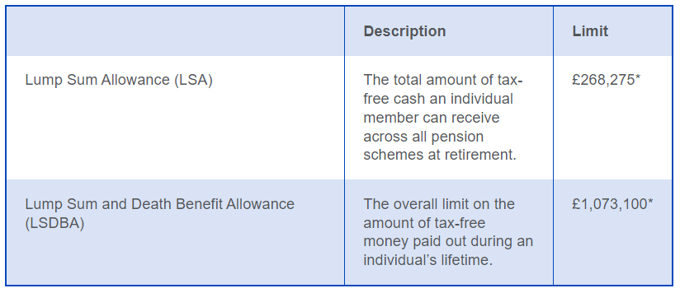
Reminder: Lifetime Allowance
From 6 April 2024, the Government has abolished and replaced the Lifetime Allowance (LTA) with two new allowances
*If one has Lifetime Allowance protection or applied to HM Revenue & Customs
for a protected allowance, one may be entitled to a larger amount.

Slide 29
Annual Allowance

Slide 30
What is the annual allowance?
This is the limit by which the value of your pension savings can go up in any year (Pension Input Period) before you may have to pay tax on the amount saved over the Annual Allowance limit.
2023 - 2024
limit: £60,000
Notes:
The annual allowance is a limit to the total amount of contributions that can be paid into a defined contributions scheme, or the total amount of benefits that you can build up in a defined benefits scheme, for tax relief purposes.

Slide 31

Who receives a PSS?
To receive a 2023/24 PSS, a member must meet one or more of the following criteria.
They exceeded the 2023/24 Annual Allowance limit of £60,000*
They earned over £100,000 in the 2023/24 scheme year.
They requested a PSS in advance of the annual statements exercise.
Notes:
*members may have a different LTS as we will discuss

Slide 32

Tapered annual allowance 2023-2024 tax year
Members with total income over £260,000 will have their annual allowance limit reduced.
For every £2 their income is over £260,000, their annual allowance limit reduces by £1.
The minimum reduced annual allowance you can have in the current tax year is £10,000
https://www.gov.uk/guidance/pension-schemes-work-out-your-tapered-annual-allowance
Notes:
.Total income includes income outside of the civil service. Members can find further guidance for working tis out on HMRC’s website
https://www.gov.uk/guidance/pension-schemes-work-out-your-tapered-annual-allowance

Slide 33

Pension Input Period - PIP
The PIP is the 12 month period we look at to establish how much a member’s benefits have increased by for AA purposes.
It’s aligned with the tax year and has been for all schemes since 2016.
6th April
5th April
Notes:
The Civil Service scheme’s PIP used to run from 1st Jan – 31st Dec. From 2016 All Pension Schemes moved to a PIP aligned with the tax year.
So when we look at whether a member has exceeded or kept within the AA amount, we have to measure the increase in benefits across a period of time. This is known as the Pension Input Period.

Slide 34
Pension Input Amount – Defined Benefit
The Pension Input Amount (PIA) is the value we use to measure against the AA limit for
defined benefit schemes calculated as:
16 times the pension built up in the PIP year, plus
The increase in any automatic lump sum within the PIP year
The pension and lump sum figures from the beginning of the PIP are always adjusted by P.I. first.

Slide 35
Annual Allowance example
alpha pension at the start of PIP = £2,320
adjusted with % inflation (£46.40) = £2,366.40
Total alpha pension at the end of PIP= £2,946.40
£2,366.40 - £2,946.40=
Difference of £580
Difference of £580 x 16 = £9,280 – no breach
Notes:
Note – if the member sis purchasing top up options, that would also be included when calculating their PIA using the same calculation as above.

Slide 36
Pension Savings Statements
A PSS will be automatically issued by 6th October to all members who have:
Breached the AA limit in the previous PIP
Earned more than £100,000 in the previous PIP
Anyone who has requested one in advance
Un-used allowance from the previous 3 PIP years can be carried forward and used.
Notes:
6th October is the legislative deadline. We aim to have PSS’s issued by 31st August wherever possible. Any member can request a PSS at any time.
E.g. a member may have a pension elsewhere that is close to the AA limit, therefore they request a PSS from us to see if both of them combined equals a breach.

Slide 37
What do you need to provide?
Your regular
March and April interface
Confirmation of CARE year end closure
Additional five-day PIP (Pension Input Period) information
Notes:
Your regular march and April interface. 0.5% error compliance rate.
Confirmation of CARE year end closure - closing down the financial year for CARE scheme members.
Additional five day PIP information via a manual interface
Important - Failure to submit your end of year data on time may result in inaccurate Annual Statements or even non-distribution of statements to members who are eligible to receive one.

Slide 38
Additional five-day PIP information
Your monthly interface provides us with data
up to the last day of the previous month.
The PIP runs from 6th April – 5th April therefore, we need the additional five days of data to produce
Pension Savings Statements.
Notes:
Important - Failure to submit your end of year data on time may result in inaccurate Annual Statements or even non-distribution of statements to members who are eligible to receive one.

Slide 39

Member actions on receipt of PSS
Check information on PSS looks correct
Attend a tax awareness training session
Establish if they have a tax charge – if they think they do they can then request a one-to-one session
If they do have a tax charge, decide how they will pay.

Slide 40
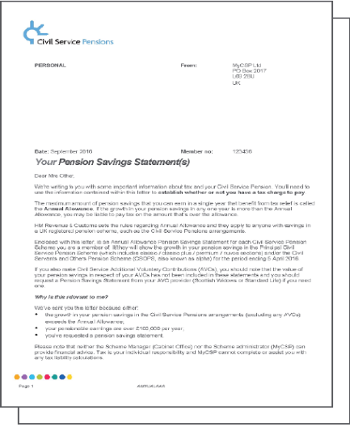
Pension Savings Statement (PSS)
Includes:
Personal details
Latest base pay
Civil Service Pension Scheme membership details
Pension Input Amount for the latest Pension Input Period
Pension Input Amount from the three previous Pension Input Periods
Doesn’t include:
Details of non-Civil Service pension arrangements
Carry forward from prior Pension Input Periods
Details of all pensionable and taxable pay
Details of any other income
A personal annual allowance
Details of contributions paid

Slide 41
Tax charge
The PSS will tell the member if they have exceeded the limit, not what the resulting tax charge is.
It is the member’s responsibility to determine if they have a breach and to report the breach to HMRC and calculate the resulting tax charge.
http://www.hmrc.gov.uk/tools/pension-allowance/
Direct payment to HMRC
Can have tax code adjusted to make payment
The member must complete a self assessment tax return if they have a tax liability
Notes:
HMRC have a calculator to help members calculate the resulting tax charge (link on slide).

Slide 42

Scheme pays - mandatory
The scheme must offer for the tax charge to be taken from the members pension benefits if the following conditions are met:
The tax charge for that year must exceed £2,000.
The pension savings in the same tax year has exceeded the AA.
The breach has occurred from one scheme only.
Notes:
Scheme pays voluntary – the above conditions are not met but the member still wants to apply for the tax charge to be taken from their scheme benefits.
The member applies using the ‘scheme pays quote request’ form on the member forms page of our website.
https://www.civilservicepensionscheme.org.uk/media/536543/annual-allowance-scheme-pays-quote-request-july-2019.pdf

Slide 43
PSS - Remedy

Slide 44
Remedy impacted members
By October 2024 they will receive recalculated PSS for the remedy period
HMRC have granted an extension for these members to meet any potential tax charge
Notes:
We will recalculate their Pension Input Amounts (PIAs) and issue revised PSS for the 2022/23 tax year to them by 6 October 2024. We will provide separate communications to these members with further details about this process.
The deadline for Remedy affected members to ask the scheme to pay all, or part, of an Annual Allowance tax charge (a scheme pays election) for 2022/23 has been extended to 6 July 2025, unless you were a pensioner on 1 October 2023 in which case the deadline is 8 July 2027.

Slide 45

PSS MI
28 June
Indicative
18 October
Final
Notes:
When you receive your indicative MI check over it and if there is anyone missing that you think should receive a PSS or vice versa – let us know.
recipients of remedy PSS are expected to be high in number due to the time frame involved in the remedy period

Slide 46

Remedy impacted members
To receive a Remedy PSS, a member must be subject to the 2015 Remedy in addition to one of the following reasons:
They exceeded the Annual Allowance in any year before or in 2022/23.
They earned over £100,000 in any year before or in 2022/23.
They requested a PSS in any year before or in 2022/23.
Notes:
We will recalculate their Pension Input Amounts (PIAs) and issue revised PSS for the 2022/23 tax year to them by 6 October 2024. We will provide separate communications to these members with further details about this process.

Slide 47
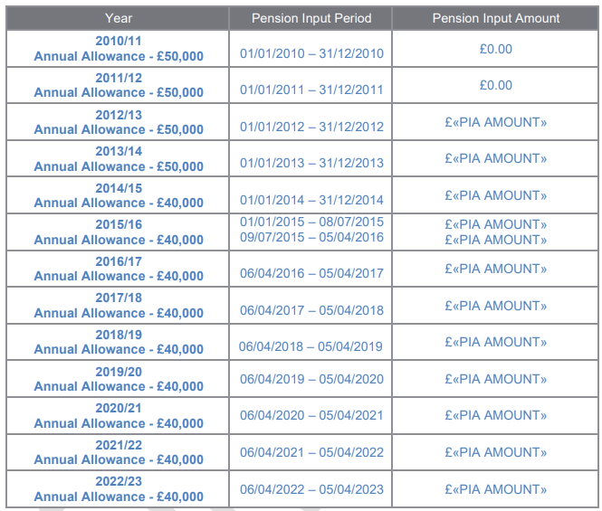
What will be included
Notes:
We must include all information from the remedy period and the years prior as carry-forward will need to be included for members to determine their situation and therefore action they may want/need to take.
There will be two of these tables, one for legacy, one for alpha so members can have all information they need to make their own informed decision.

Slide 48
Important notes
Members who qualify to receive a PSS and are impacted by the 2015 Remedy may receive two statements this year. One for the Remedy period and 22/23 tax year, and one for the 2023/24 tax year – if applicable.
Recipients will need to use the Pension Input Amounts (PIA) information provided in their PSS along with ”HMRC’s Pension Annual Allowance” tool at gov.uk to determine their position.
A tax charge for either the Remedy period, or the 2022/23 tax year must be reported on the ”Calculate your public service pension adjustment page” at gov.uk. Members should not report it through self-assessment as in previous years.
A tax charge relating to the 2023/24 year should be reported through self-assessment as normal.

Slide 49

Further support to come
Due to the complexity of this issue the scheme manager are planning on providing more tools for affected members to help them manage the actions required on receipt of the RPSS.
This includes:
enhancements to the am I affected tool
a video guide walking through the RPSS statement
guidance on using HMRC's new calculator tool

Slide 50
Timeline of 2023/24
ABS & PSS

Slide 51
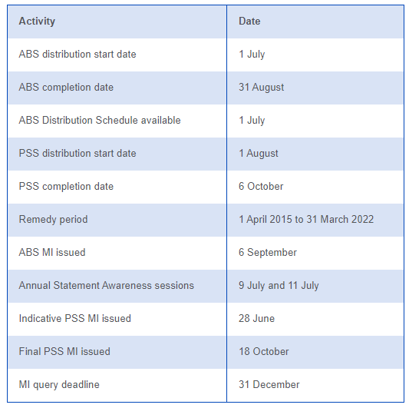
Timeline of 2023/24 events

Slide 52
More information
EPN 711
Notes:
We expect another EPN with more info on PSS to be issued over the summer

Slide 53
Any questions?

Slide 54

Support for members receiving a
Pension Savings Statement

Slide 55
Support to be provided
Products to support members affected by remedy and tax include:
Enhancements to the scheme website
Enhancements to the Am I Affected? tool
New videos explaining the Remedy Pension Savings Statement
Guidance on using the new HMRC tax tool created for remedy affected members

Slide 56


Tax Support
Employers may wish to provide group tax sessions for anyone who receives a PSS.
They can be funded by the member or by the employer.
2024 sessions to be delivered via Microsoft Teams or face to face upon request.
remain our provider for tax support services

Slide 57
Documentation required
Civil Service Pension Savings Statement and LTA letter for 2023/24
Annual Benefit Statement for 31 March 2024
Current rate of pensionable pay
March 2024 payslip
Details of any other income (from other sources) for the 2023/24 tax year
Notes:
Details of what is required will be communicated at the time of booking, as this could change

Slide 58

Tax support
Open group sessions
One to ones
In-house group sessions
Notes:
All prices to be confirmed by Isio

Slide 59
Group tax sessions
90 minutes - £1,950 + VAT for up to 25 delegates
In house/Open
Documentation required
https://mycsp.co.uk/pension-learning/member-learning/group-pension-tax-awareness/
Notes:
Documentation will be required, also we will be asking for attendees to do pre-work before sessions to ensure they get the most out of them.

Slide 60
One to One sessions
If applicable, tax charge is identified
Tax specialist
45 minutes
£975+ VAT
£525 + VAT for a follow-up*
Phone call/ Webinar/ face to face
Notes:
First time recipients of a PSS (breaching new £60k) AA - we recommend they go straight to a 121

Slide 61
Member journey on receiving a PSS
Member receives PSS/RPSS
Visit scheme website. Use resources to help understand what action is required
If member needs further support a group tax session should provide the answers they need. First time recipients may benefit from a one to one instead.
If they have a change in their tax position (under or overpayment) they may require one to one support
A follow up one to one is also available if they need further guidance

Slide 62

How to book
Email taxsupport@mycsp.co.uk
MyCSP will advise of availability and issue booking form
Complete and return booking form
Confirmation email sent
https://mycsp.co.uk/pension-learning/member-learning/group-pension-tax-awareness/

Slide 63
Further support for employers
ABS & PSS landing pages
Tax awareness training for PSS recipients
Your ERM
Notes:
Please do not send individual member queries to this e-mail address.

Slide 64

Other pension training

Slide 65






Member Learning
Notes:
We do have further courses on offer as listed here. Note: the tax related sessions are for member’s who have received a Pension Savings Statement (PSS). If you’re interested in these courses, either yourself or your employer can fund them. More information is available at www.mycsp.co.uk – all of these courses are available to New Fair Deal members

Slide 66



New Joiners
Data & Interface
Civil Service Compensation Scheme
Help is at hand
Ill Health, Injury Benefits & Death
Schemes, Retirement & Leaving

Slide 67
Training feedback
Our Net Promoter score in June 2024 was 85.3
Over 143,000 members have attended a Pension Power session since July 2018
This was an excellent and informative session with myth busting addressed which was extremely helpful. I have grappled with this subject for many years and for once I think I understand the basic principles. Thank you so much!
Pensions were something I didn't have a grip on, and this has massively helped and will be extremely beneficial for forming my long-term plans- Excellent!
Absolutely clearly presented, even though I thought I was clued up!
The presenter was great, so knowledgeable. there’s so much I wasn't aware of. thank you, Cabinet Office, for these courses!

Slide 68
PAW - Save the date!
Pension Awareness Week 16th to 20th September.
All can pre-register now & be notified when registration opens.
Webinars are free but have limited places
& are allocated on a first-come, first-served basis.
Pre-registered members will be notified as soon as registration opens and will have first choice of sessions before they fill up.
There will be a further EPN to issue further details of webinar content and when general registration opens
Refer to EPN 712 to pre-register

Slide 69
Any questions?
Copyright MyCSP Limited 2024. The reproduction or transmission of all or part of these slides is prohibited. The information contained in these slides is confidential to MyCSP limited and you may not disclose it to anyone.

