Slide 1


INFO-MGH-MG1.REF GUIDE.PENSIONS-APR 2025
MedigoldOne
Referrer Guide

Slide 2


Referrer Guide
What is changing?​
  A new system (MedigoldOne) through which to make Applications and Appeals ​
  The current system (HMLO) is being decommissioned in Q3 2025​
​
When is it changing?​
  28th April 2025​
​
Why is it changing?​
  Health Management Ltd – The Scheme Medical Advisor – was acquired by Medigold Health in March 2023​
  HMLO – the current system – is nearing end of life and must be decommissioned​
​
How is it changing?​
  The security working group has signed off the changes​
  New forms and user accounts have been created for you​
  The admin team, SMAs and overall process will remain the same
Pension Applications are changing

Slide 3
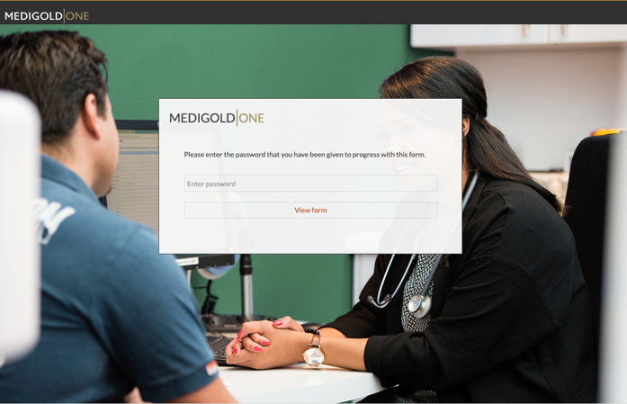
Referrer Guide
Introduction​
Your migration across to Medigold’s systems is scheduled for 28th April 2025, so you should begin using MedigoldONE exclusively to request services from this date. Please note that no new requests may be made on HML Online after 24th April 2024, although there will be read-only access available until all applications are completed.​
Cases submitted via the HML Online system up to 24th April 2025, will continue to be managed through HML Online until their completion. Service requests for new cases must be submitted via MedigoldONE from 28th April 2025.​

Slide 4

Referrer Guide
This means there will be a period where users may need to use both systems if they have ongoing cases in HML Online that have not been concluded by the above go-live date​.
All service requests should be made through MedigoldONE using the form links provided to department superusers​.
As well as receiving two invoices initially, you will notice some changes to the product names on your invoices and the information received on your backing sheets. Your Relationship Manager will be on hand to support with any queries you may have in relation to these changes, and your Finance team will receive a guide with the first new invoice issued.

Slide 5
Referrer Guide
Checklist for Civil Service Pensions Referrals​:
​
To make a referral you will need the following as a minimum:​
  The Referrer details and Case Worker/Line Manager details if different​
  The employee/member’s personal details (including full name, date of birth, contact details via phone, post and email)​
  The employee/member’s employment details (job title, contracted hours, dates where relevant)​
  The pension scheme the employee/member belongs to, along with scheme pension age and also state pension age where relevant​

Slide 6
Referrer Guide
Checklist for Civil Service Pensions Referrals​:​
You will also need the relevant Civil Service Pensions application form:​
  For IHR, you will need a fully completed IHR1 P1 from member and P2 from employer along with any recent OH reports, and other documents listed in IHR1, if applicable.​
  For EPPA, you will need a fully completed EPPA1 P1 from member and P2 from employer, along with any OH reports and other documents listed in EPPA1, if applicable. ​
  For Appeal, you will need a fully completed APP1 P1 from member and P2 from employer along with original SMA outcome, and other documents listed in APP1, if applicable. ​
​

Slide 7

Referrer Guide
How to make a good referral
  If you are unfamiliar with the process, please read the Civil Service Pensions Ill Health Retirement (IHR)- Procedural Guidance for Employers (Annex 6J).​
  The relevant Civil Service Pensions application form (IHR1, EPPA1, APP1) should be fully completed- P1 by member and P2 by employer.​
  Include all the documents listed at the end of the relevant Civil Service Pensions application form with the referral, in PDF format and appropriately labelled. ​
  If the relevant Civil Service Pensions application form has been suitably completed, all the information required for the MedigoldOne Referral form should be available. ​

Slide 8
Referrer Guide
How to make a good referral
  If you are unfamiliar with the process, please read the Civil Service Pensions Ill Health Retirement (IHR)- Procedural Guidance for Employers (Annex 6J).​
  The relevant Civil Service Pensions application form (IHR1, EPPA1, APP1) should be fully completed- P1 by member and P2 by employer.​
  Include all the documents listed at the end of the relevant Civil Service Pensions application form with the referral, in PDF format and appropriately labelled. ​
  If the relevant Civil Service Pensions application form has been suitably completed, all the information required for the MedigoldOne Referral form should be available. ​

Slide 9
Referrer Guide
How to make a good referral
  Please ensure that all the required documents are attached in the correct order and format, otherwise it may result in a delay in processing and/or the referral being rejected. ​
  If the employee is terminally ill with limited life expectancy, include any available medical evidence confirming diagnosis and prognosis so the referral can be fast-tracked.

Slide 10
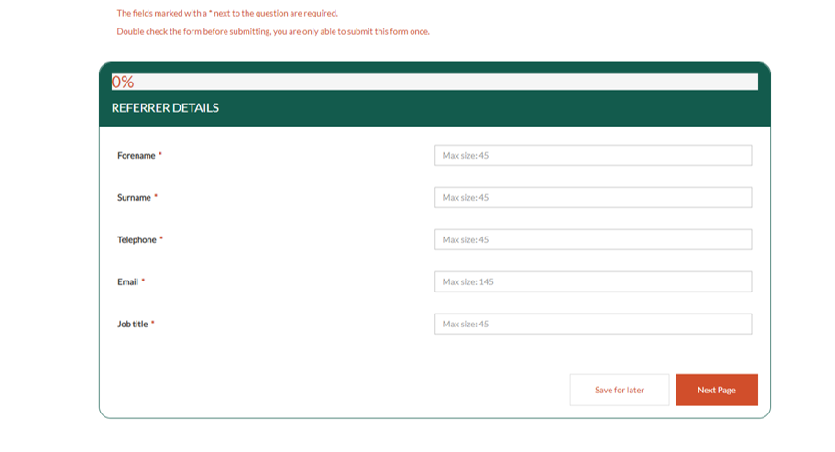
Referrer Guide
Completing the Pension or Injury Benefit Application Form
  To access the Pension or Injury Benefit Application visit the URL www.medigoldone.com and login with your username and password.

Slide 11
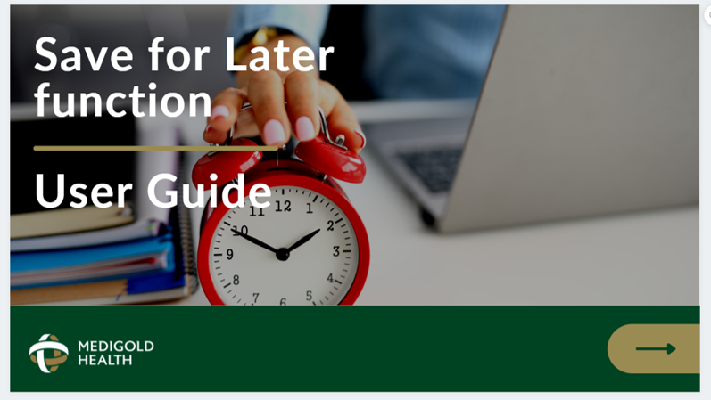
Referrer Guide
  When submitting your Pension or Injury Benefit Application, if at any time you wish to save your progress and come back to the form later on, you can use our handy Save for Later function (please refer to our Save for Later - User Guide for further details on how to use this feature).

Slide 12
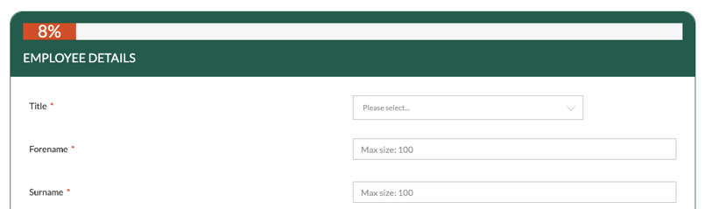
Referrer Guide
Completing the Pension or Injury Benefit Application Form
  Mandatory fields (marked with an asterisk*) are included to ensure that all essential data is captured before you progress to the next section.
  Please complete all fields with as much detail as possible, checking that all contact information is accurate and up-to-date as we will use this to communicate with your colleague about their consultation and report and to keep you updated about the progress of the case.
  Please provide your own details in the Referrer Details section.
If copying and pasting any information into the form, please ensure that you do not include any spaces before or after, or within phone number details.

Slide 13
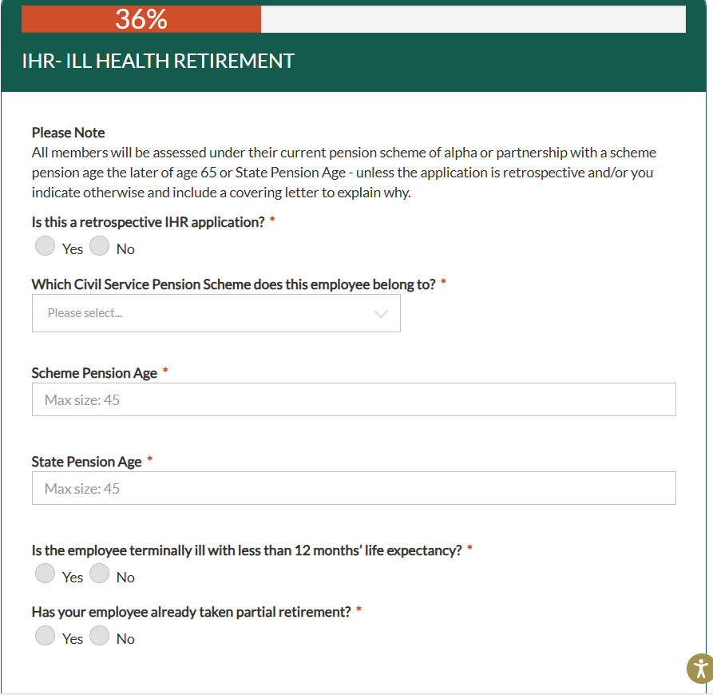
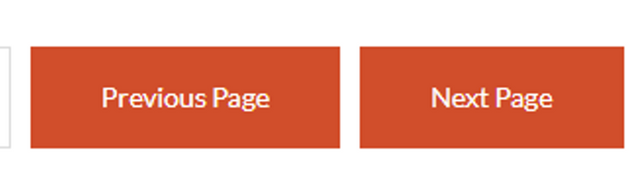
Referrer Guide
Completing the Pension or Injury Benefit Application Form
  Continue working through each section of the form.
  You can use the Previous Page and Next Page buttons to navigate back and forth between the different sections should you wish to add further detail or check the information you have previously input.
  If you are unable to progress to the next page, please ensure that you have completed all mandatory fields.

Slide 14
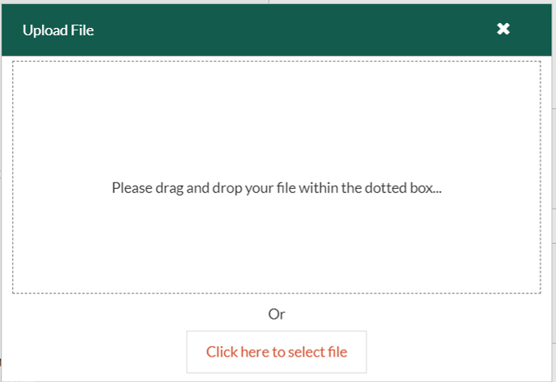
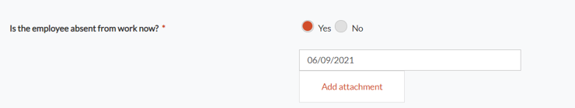
Referrer Guide
Completing the Pension or Injury Benefit Application Form
  Use the Add attachment button where displayed throughout the form to upload copies of important documents that are relevant to the case, such as consent forms, GP fit notes, or absence records.

Slide 15
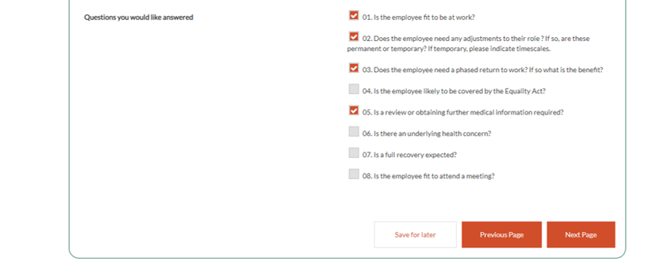
Referrer Guide
Completing the Pension or Injury Benefit Application Form
  Towards the end of the form, you can select which questions you would like our clinician to consider during the assessment and answer in their report.
Please note, the pre-set questions displayed here are examples only and may be different on your application form.

Slide 16
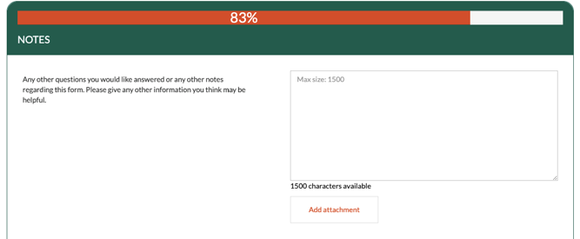
Referrer Guide
Completing the Pension or Injury Benefit Application Form
  You will also have space to add your own questions (and provide additional notes). To ensure the clinician is able to address each question effectively with your colleague, we apply a maximum of 14 questions per consultation.

Slide 17
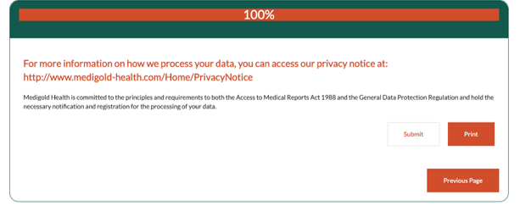
Referrer Guide
Completing the Pension or Injury Benefit Application Form
  Once you have completed the form before clicking submit you will have the option to print a copy of the application form (this will automatically give you the option to save a pdf version too).
  On clicking ‘Submit’ the Pension or Injury Benefit Application will be sent through to your Customer Service Team for processing and you will receive an on-screen acknowledgment confirming that it has been received.
MedigoldONE is fully GDPR compliant and you can access our privacy notice from this page.

Slide 18
Referrer Guide
Submitting the Pension or Injury Benefit Application Form
  In addition to the on-screen acknowledgment, you will also receive two auto-generated emails from the MedigoldONE portal, one providing a URL to your personal dashboard displaying your open case(s), the other providing a randomly generated password.
  You will use this password to access your dashboard to view this form and any future applications that you make.
  Please ensure that you retain these details and keep them secure.
  If you forget your password, simply click on the Forgotten Password link.

Slide 19
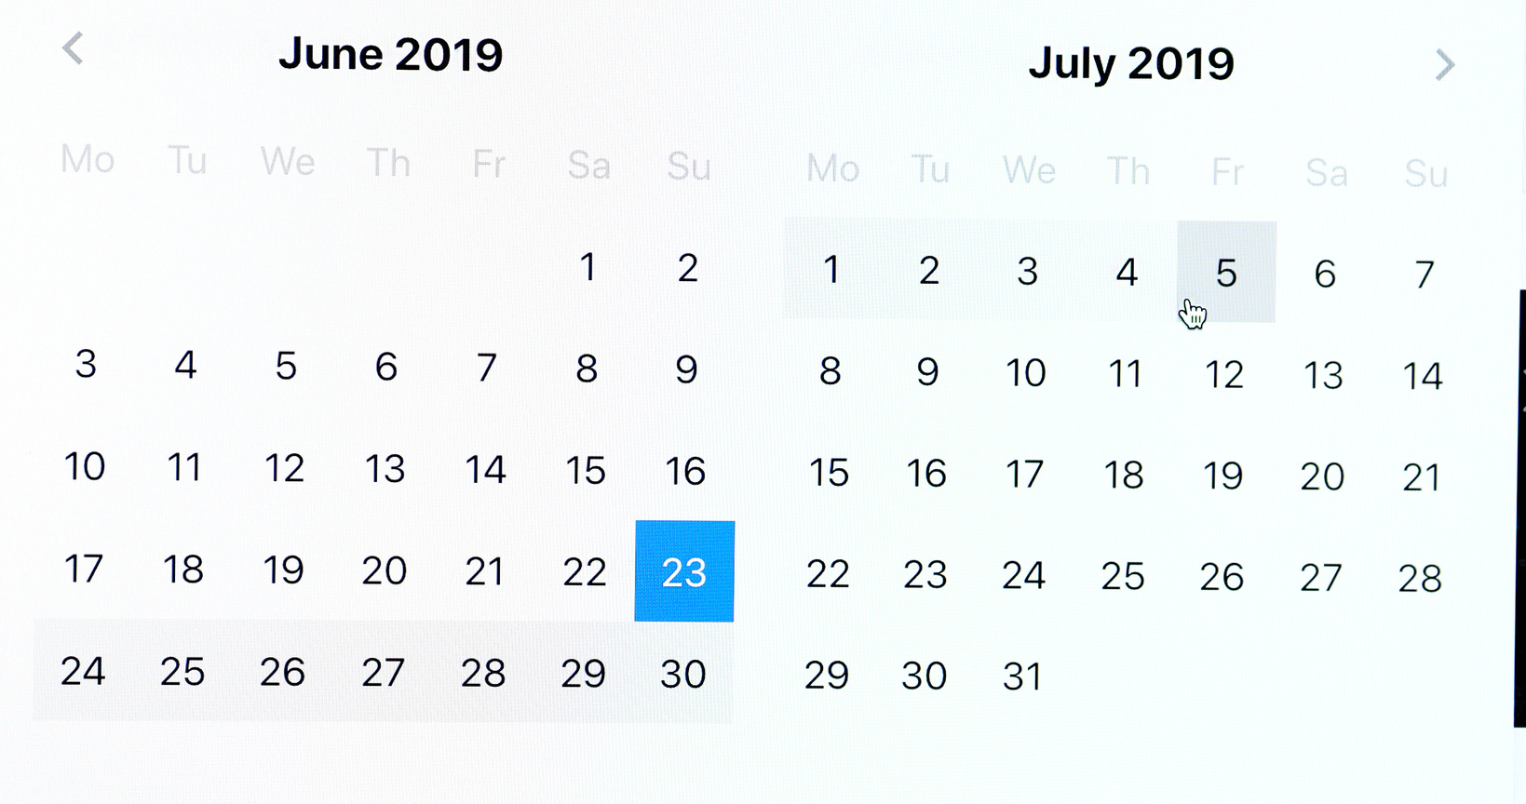
Referrer Guide
After you have submitted the Pension or Injury Benefit Application Form
  Once received, the application will be reviewed by our Clinical Triage Team to determine the most appropriate appointment type.
  Your Customer Service Team will then schedule the appointment and notify your colleague of the details via our Appointment Notification and Consent process.
  Further details of this process and how your colleague can access information about their appointment are provided in our Medigold Health Appointment Notification & Consent – Colleague Guide.
  After the appointment has taken place, the assessing clinician will prepare their occupational health report in readiness to issue to you and your colleague.

Slide 20
Referrer Guide
Viewing the Pension or Injury Benefit Application Form and uploaded documents
  As the case progresses, you will receive updates via auto-generated email notifications every time the status is updated or an appointment letter or Occupational Health report is uploaded to your colleague’s record.
  You can view the colleague’s case and access any uploaded documents by logging in to the MedigoldONE portal using your personal login details and clicking on the MR tab.

Slide 21
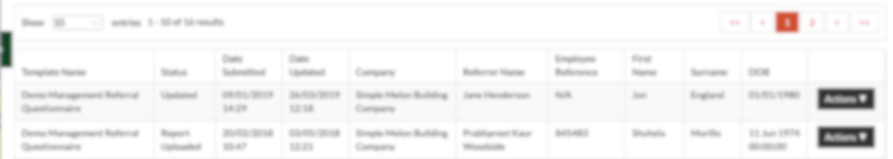
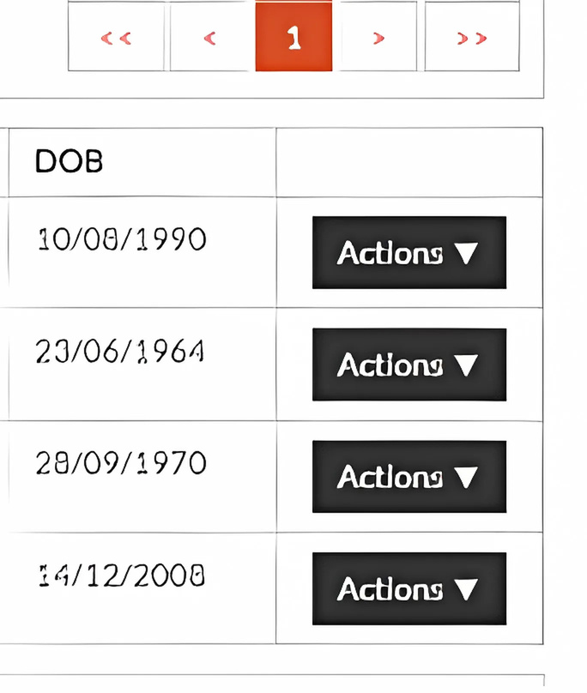
Referrer Guide
Viewing the Pension or Injury Benefit Application Form and uploaded documents
  Once logged in to your dashboard, you will see all your ongoing cases displayed. To view the referraand any uploaded documents for a specific colleague, select the Actions button against their case

Slide 22
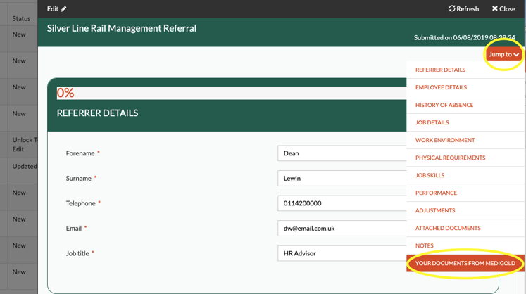
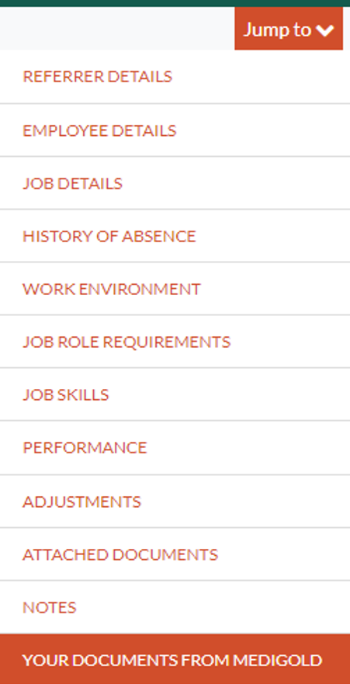

Referrer Guide
Viewing the Pension or Injury Benefit Application Form and uploaded documents
  When viewing the case, you will be able to see the full f form that was originally submitted.
  To access any uploaded documents, you simply need to click the Jump To button and select Your Documents from Medigold from the dropdown to take you directly to this section of the form.

